Slide 1






TOUCHLESS ATTENDANCE SYSTEM
By Shubham Kumar (24BDA70192)
Aditya (24BDA70213)
Kaleem (24BDA70195)

Slide 2
TABLE OF CONTENTS
Problem Statement
Introduction
Project Goal
Needs
External Features
Internal System Workflow
Process Storyboarding
System Benefits
Conclusion & Future Scope

Slide 3


PROBLEM STATEMENT
Manual attendance systems are slow and can have mistakes.
Proxy attendance (someone marking attendance for others) is possible, making records unreliable.
Hard to track exact entry and exit times for individuals.
Generating accurate reports from paper registers is difficult and time-consuming.
Big organizations face more challenges as the number of users grows.
There is a need for a fast, automatic, and secure way to accurately record attendance for everyone.

Slide 4

INTRODUCTION
Using face recognition makes attendance faster and safer by identifying people using their faces. This project uses face features taken from webcam photos to recognize people quickly and mark their attendance automatically.
The system has an easy-to-use interface where users can register, the system detects faces live, and attendance is recorded with the time. This way, attendance is correct, mistakes are less, and the process is faster, making it useful for schools and workplaces.

Slide 5


PROJECT GOAL
Capture a person's face image using a webcam.
Extract distinctive facial features (embeddings) from the image.
Compare the extracted features with stored face embeddings.
Identify the person if a match is found.
Automatically record attendance with the person's name, ID, date, and time.
Prevent duplicate attendance entries for the same person on the same day.

Slide 6

NEEDS
Webcam: For live face capture and recognition.
Python: Main programming language, chosen for flexibility and powerful libraries.
OpenCV: For image processing and webcam interfacing.
face_recognition: For extracting and matching face embeddings.
Tkinter: For building the graphical user interface.
CSV/Pandas: For handling and storing attendance data.

Slide 7
EXTERNAL FEATURES
User Registration:
Use the "Registration" tab to enroll new users by entering UID and Name, and capturing face images.
System saves images for embedding generation and confirms success via a popup.
Real-Time Face Recognition Attendance:
Click "Attendance System" to start login scanning.
System detects faces, matches with stored data, shows confirmation popups, and logs both login and logout time.
Data Export to Excel:
Use the "Export" button to save attendance logs as Excel files.
System confirms export and creates new folder for files.
Delete User:
Enter UID in "Delete User" tab and confirm to remove all related data and embeddings.
Change Password & Contact:
Update password securely via dedicated popup module.
Access help/contact for support directly from GUI.

Slide 8
INTERNAL SYSTEM WORKFLOW
Registration Module:
Collects UID, name, and captures face images via webcam.
Saves images and then convert it to the 128D numerical vectors unique to face_embeddings file in TrainingImageLabel folder for future recognition and then delete the saved image automatically .
Face Embedding Creation:
Uses face_recognition library to convert images into 128D numerical vectors unique to each face.
Stores embeddings for quick matching during attendance.
Real-Time Detection & Recognition:
Captures live video, detects faces frame-by-frame.
Extracts embeddings of detected faces and compares them to stored data.
Recognizes individuals above confidence threshold, logs attendance (login/logout time).
Attendance Marking & Logging:
Attendance details (ID, name, timestamp) recorded in CSV automatically.
Prevents duplicate entries, handles login/logout logic.
Data export module creates summary Excel files.
Performance Tracking:
Measures recognition accuracy, logs time per event, and tracks success/failure stats.
Security Functions:
Password change handling for secure access.
Deletes user and embedding information completely upon request.

Slide 9



PROCESS STORYBOARDING

Slide 10

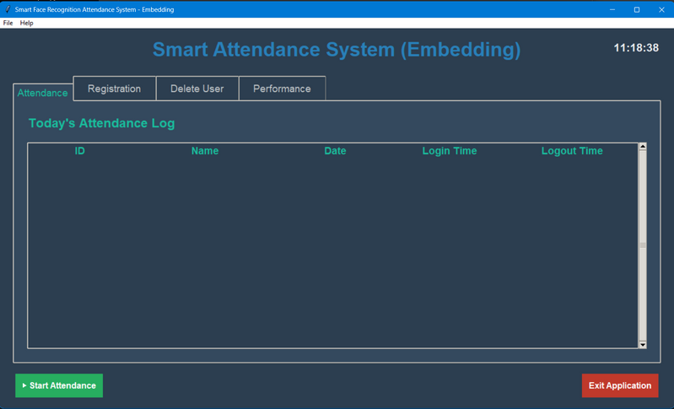
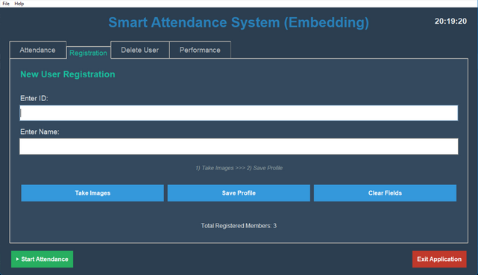
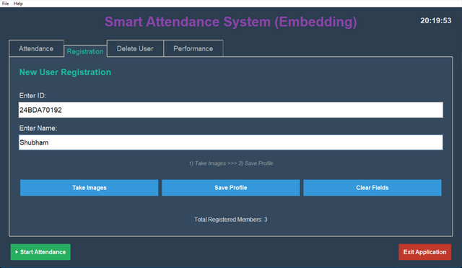


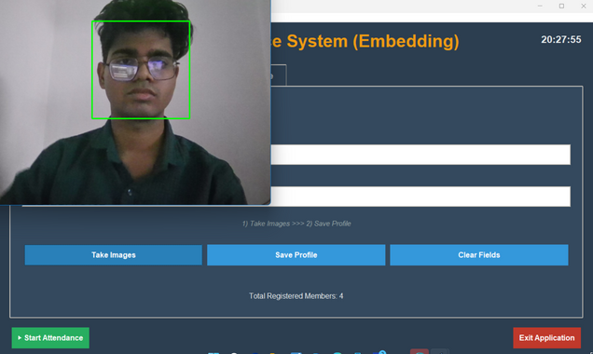
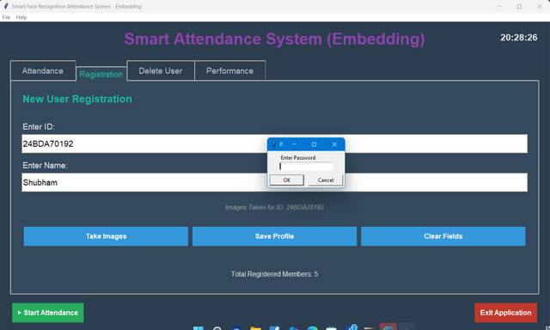
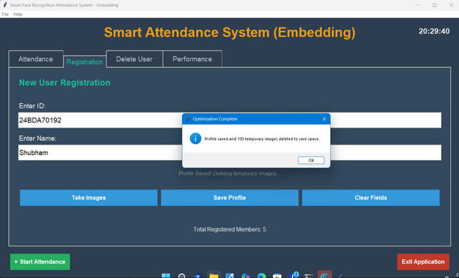
REGISTRATION
Click on Registration
Enter UID and Name
Click on Take Image
System Taking Image for training
Entering Password
Confirmation popup

Slide 11
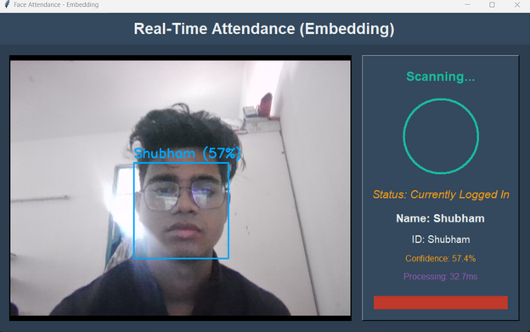
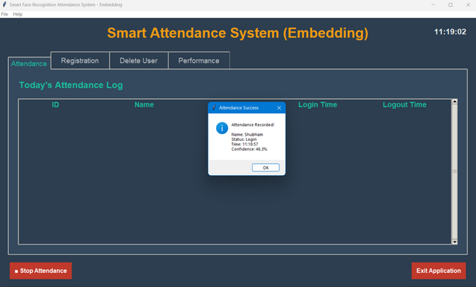
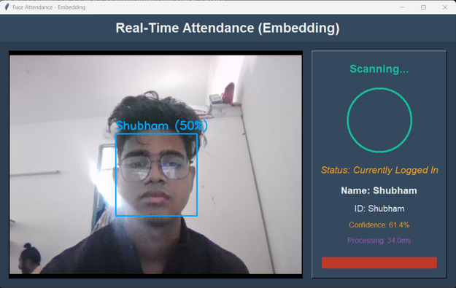
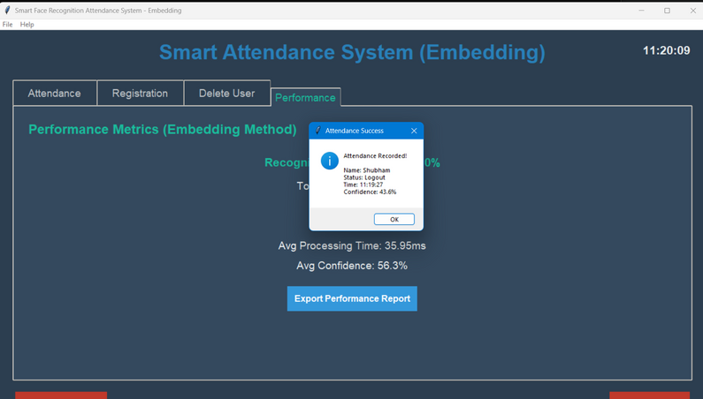
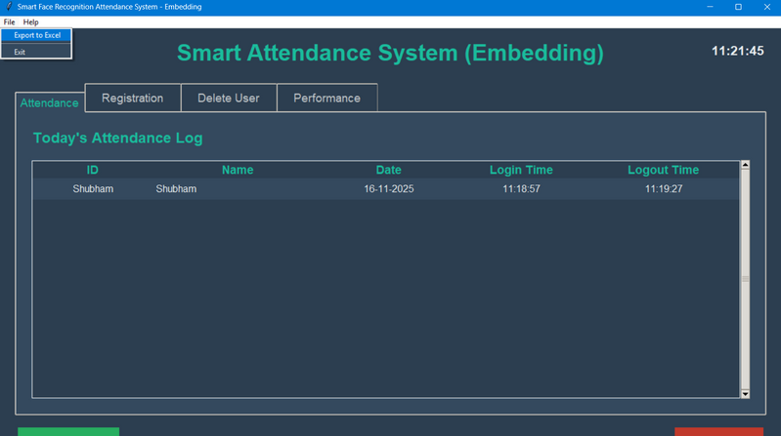
REAL-TIME FACE RECOGNITION ATTENDANCE
Click on Take Attendance
Face Scanning Begins
Login Confirmation Popup
Face Recognition in Progress
Logout Confirmation Popup
Login and Logout time recorded

Slide 12
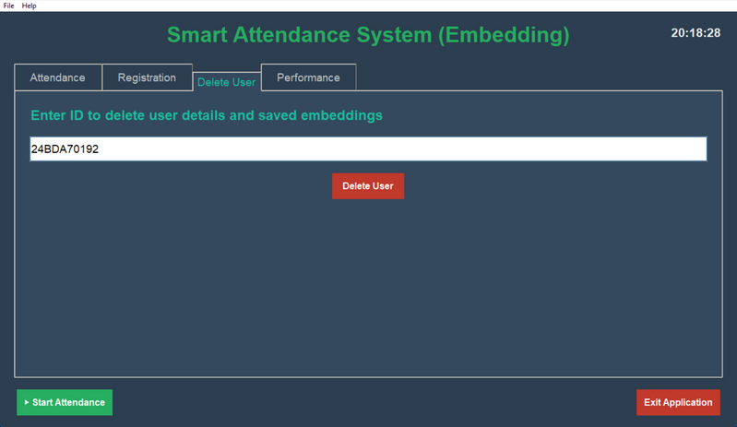
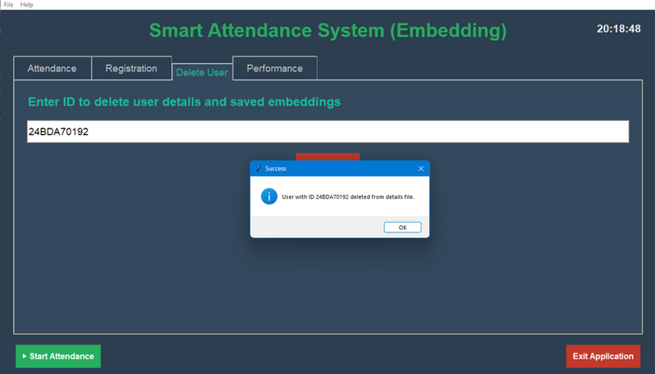
DELETE USER
Click on Delete User
Enter UID and Click on Delete User
Delete confirmation popup

Slide 13
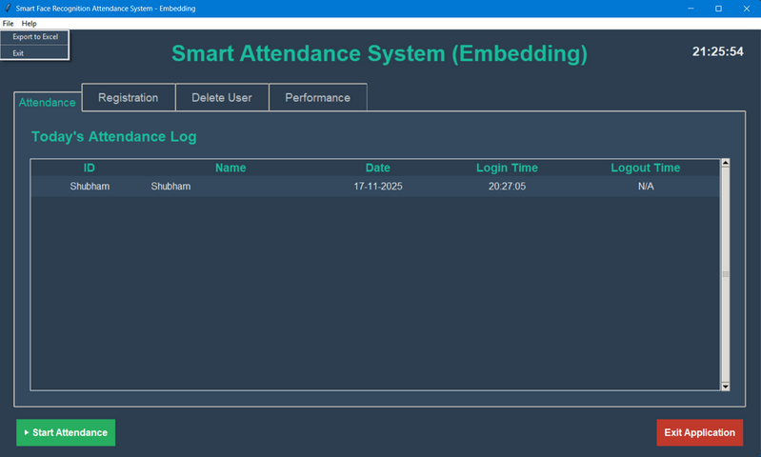
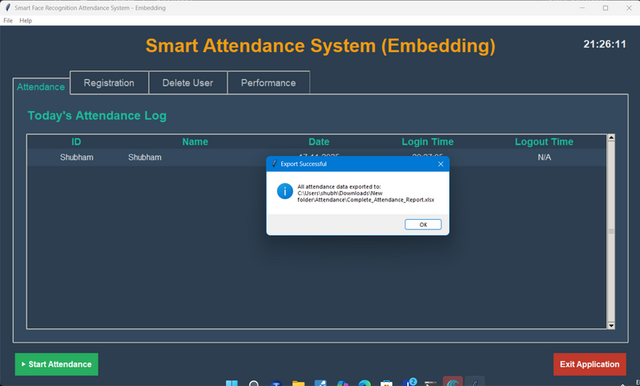

DATA EXPORT TO EXCEL
Click on File
Click on Export to Excel
Confirmation popup
Data is Exported to file Attendance in New Folder

Slide 14
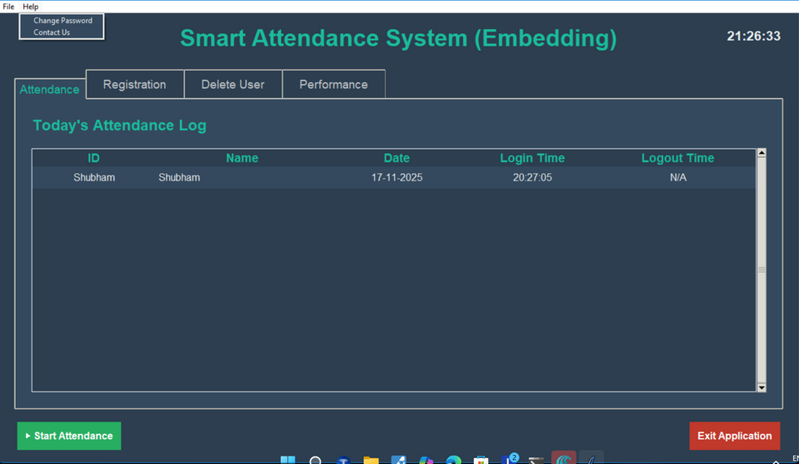
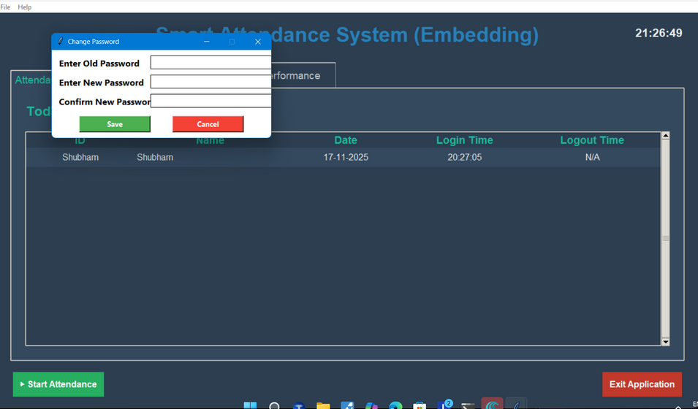
CHANGING PASSWORD
It is for the Operator
Click on Help then Change password
Enter old password then New password and Confirm password

Slide 15
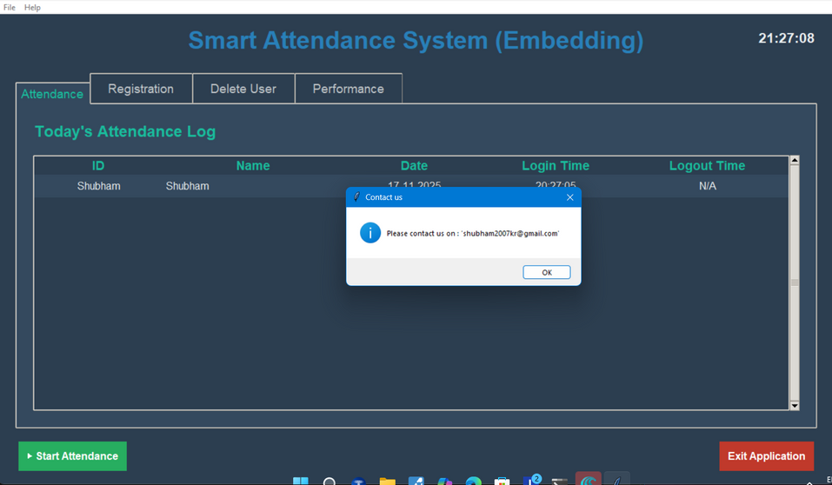
FOR CONTACT US
Click on Help then Contact Us
Email popup

Slide 16



SYSTEM BENEFITS
Delivers fast attendance marking with almost instant recognition per user, improving productivity in busy classrooms and offices.
Achieves reliable and correct results using advanced face recognition, minimizing mistakes and avoiding false attendance entries.
Operates in a contactless way, ensuring safety and hygiene by removing the need for physical touch, cards, or signatures.
Offers an error-free solution by matching unique facial features, preventing proxy attendance and manual slip-ups.
Features an easy-to-use graphical interface (GUI) that lets users register, mark attendance, and manage system settings without technical knowledge.
Automatically exports all attendance logs and data to Excel/CSV files, simplifying report generation and record-keeping for administrators.
Provides robust tools for deleting users and managing passwords, keeping system data secure and up-to-date and allowing easy removal of outdated records.
Maintains user privacy and keeps all attendance information and settings safe through password-protected access and local data storage.
Scales easily for use in classrooms, offices, and organizations with many users due to efficient coding and embedding technology.

Slide 17
CONCLUSION & FUTURE SCOPE
Conclusion
The attendance system makes presence tracking in schools, colleges, and offices much easier, faster, and more reliable.
It uses advanced face embedding technology to ensure high accuracy and security, reducing errors and preventing fake or proxy attendance.
The easy-to-use interface and automatic logging make it suitable for administrators and users of all technical levels.
The system keeps data secure and allows exporting reports for easier record management.
Its scalable design means it can handle a large number of users, making it ideal for growing organizations.
Future Scope
Mobile App Integration
Cloud Storage
Multi-Device Support
Advanced Anti-Spoofing
Multi-Face Recognition
Automated Analytics

Slide 18


THANK YOU!

